Slide 1
Irritable Bowel Syndrome and a Probiotic Agent
Statistical Analysis using ANCOVA
P. Boily, S. Hagiwara

Slide 2
Project Description
Data Preparation and Methodology
Analyses and Results
Consulting Post-Mortem

Slide 3
Project Description

Slide 4
Project Description CCNM and IBS
Irritable Bowel Syndrome (IBS) is a functional colonic disease with high prevalence.
Typical symptoms include chronic abdominal pain, discomfort, bloating, and alteration of bowel habits, and it has been linked to chronic pain, fatigue, and work absenteeism and is considered to have a severe impact on quality of life.
Although there is no known cure for IBS, there are treatments that attempt to relieve symptoms, including dietary adjustments, medication, and psychological interventions.
In 2010, the Canadian College of Naturopathic Medicine (CCNM) was commissioned to conduct a study to investigate the effect of a probiotic agent on IBS. They carried out an analysis using the hierarchical linear models (HLM). Their key findings include:
There is a strong placebo/expectation effect, and
No strong statistical evidence to suspect that the agent itself has much of an effect on mild to moderate IBS.
The CCNM was then asked to determine whether these findings still hold, when the trial data is examined using the analysis of covariance (ANCOVA).

Slide 5
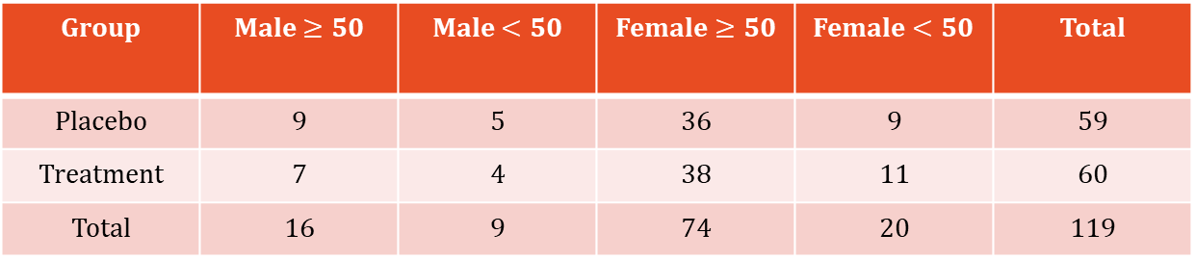
Project Description Data Collection
The recruitment procedures included advertisements on the radio, in local newsletters and newspapers, on the web and in social media. Local MDs and NDs were also given recruitment posters for their clinic in order to encourage patient referrals.
The study recruited a total of 129 participants; however, 10 participants did not provide any information past the initial measurement.
To facilitate a balanced demographical representation in each group, participants were first categorized by their gender group (M/F) and age group (< or ≧50 years). Within each subgroup, participants were then randomly assigned to treatment or placebo groups.
Randomization process is an unbalanced randomized complete block design (RCBD).
The study was conducted in a double-blind fashion.
Group | Male $≥50$ | Male $<50$ | Female $≥50$ | Female $<50$ | Total
Placebo | 9 | 5 | 36 | 9 | 59
Treatment | 7 | 4 | 38 | 11 | 60
Total | 16 | 9 | 74 | 20 | 119
Number of participants assigned to each treatment group based on their demographical characteristics.

Slide 6
Project Description Outcome Measures
The study had two response variables of interest:
IBS severity score (primary), and
IBS quality of life (QoL) measure (secondary)
IBS severity scores were collected at the beginning of the study (baseline), and at one-month intervals for next three months.
The participants were also asked to submit the QoL questionnaire at the start of the study, as well as at the second and the third month of their follow-ups.
Both severity scores and QoL scores are computed using self-reported data.

Slide 7
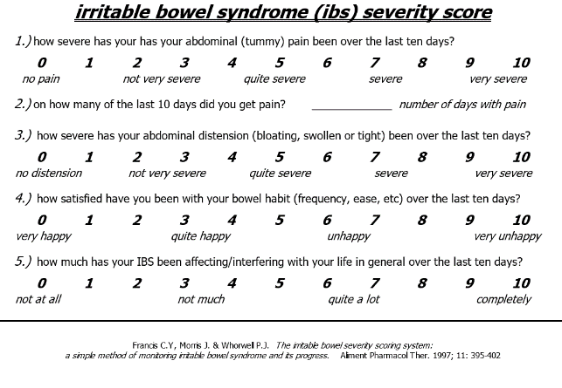
Project Description IBS Severity Score Sheet
Condition | Score
In remission | <7.5
Mild IBS | 7.5 to 17.5
Moderate IBS | 17.5 to 30
Severe IBS | 30<
Classification of IBS severity (Whorwell et al.)

Slide 8
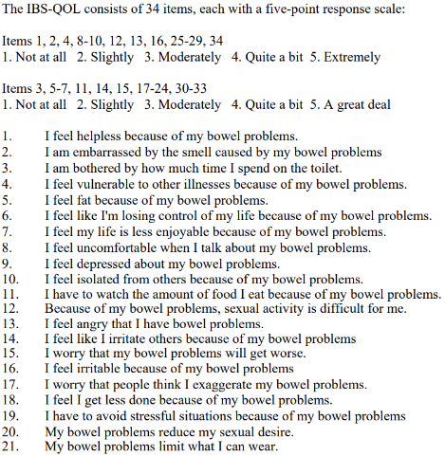
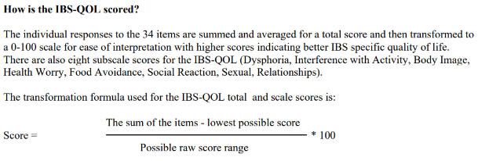
Project Description IBS Quality of Life Questionnaire (sample)
Notes:
Information Sheet on the Irritable Bowel Syndrome-Quality of Life Measure (IBS-QOL)
Seattle Quality of Life Group – University of Washington, School of Public Health, Department of Health Services
http://depts.washington.edu/seaqol/docs/IBS-QOL_Info.pdf – extracted on August 12th 2018.

Slide 9
Objective: using IBS severity score and IBS QoL measure, is there a (statistically) significant evidence to believe that the probiotic agent improves the IBS condition?

Slide 10
Data Preparation and Methodology

Slide 11
Data Preparation Drop-outs, Missing Observations, and Imputation
Out of 129 participants, 10 people did not deliver any information after the baseline measure (i.e., before the administration of agent/placebo).
In addition, there were six participants who failed to follow-up after the first or the second month of the study.
While it is difficult to study the exact reasons why some participants terminate the follow-up prematurely, it could be conjectured that participants who complete the study are either more likely to believe in the effect of the active agent or to actually be feeling the effect of the treatment than those who fail to complete the treatment.
The covariance analysis requires the dataset to be free of missing observations; thus imputations must be performed before proceeding with the analysis.
The Last Observation Carried Forward (LOCF) imputation was used in this.
Notes:
Information Sheet on the Irritable Bowel Syndrome-Quality of Life Measure (IBS-QOL)
Seattle Quality of Life Group – University of Washington, School of Public Health, Department of Health Services
http://depts.washington.edu/seaqol/docs/IBS-QOL_Info.pdf – extracted on August 12th 2018.

Slide 12
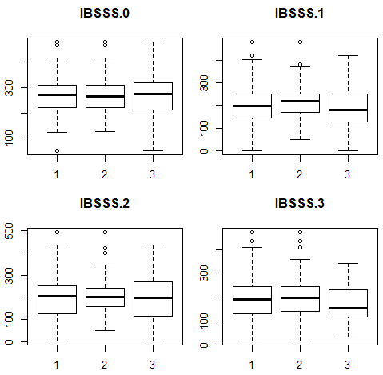
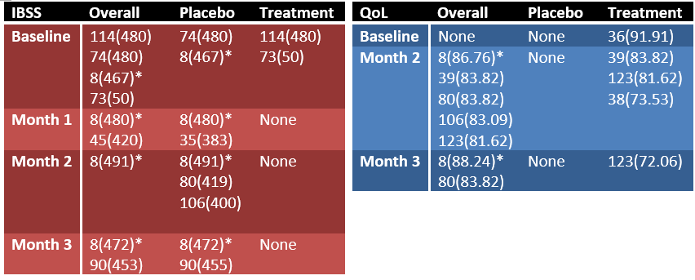
Data Preparation Outlier Detection
The box-plots (1 = all participants, 2 = placebo group, and 3 = treatment group) and summary tables show that participant #8 is considered anomalous at all observations except for the baseline measure of QoL.
List of outliers and their values.
Boxplots of IBS severity scores.
Notes:
In summary table, the numbers refer to participant ID, while the numbers in bracket denote their scores.

Slide 13
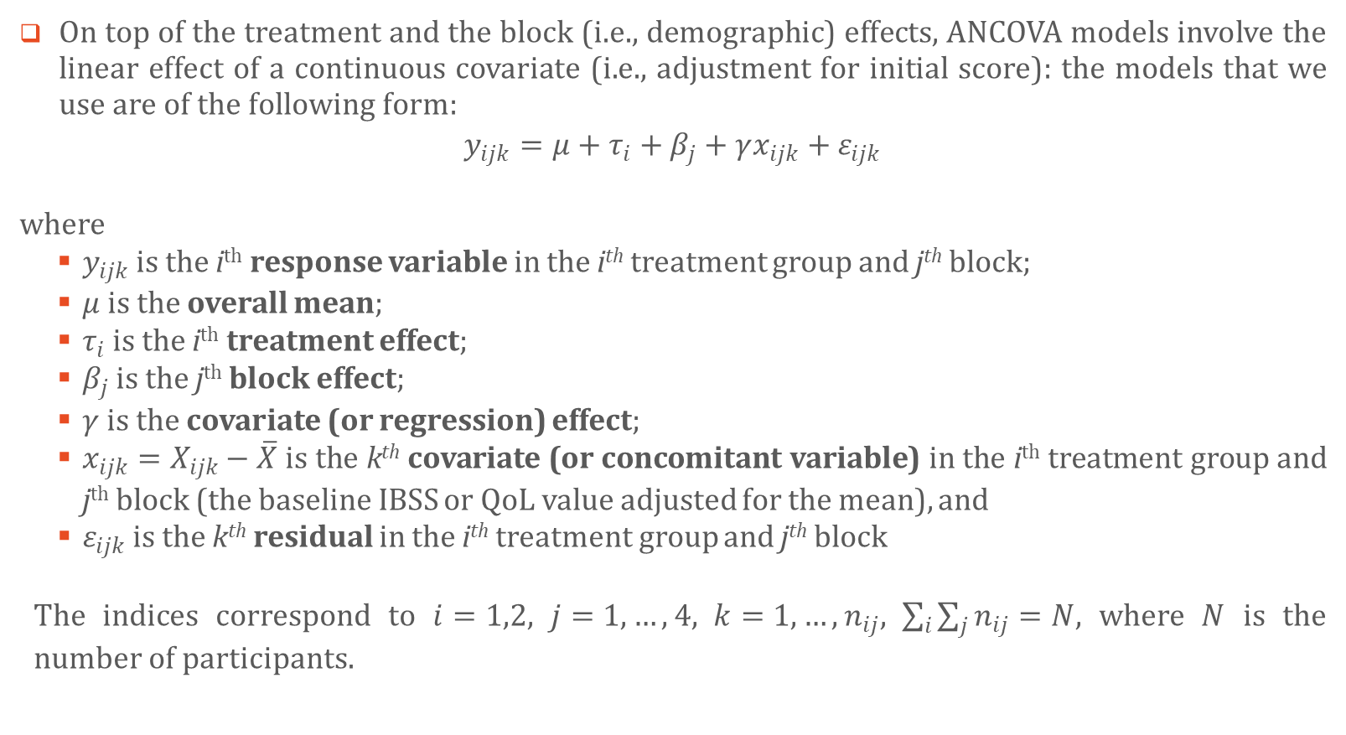
Methodology ANCOVA Models
On top of the treatment and the block (i.e., demographic) effects, ANCOVA models involve the linear effect of a continuous covariate (i.e., adjustment for initial score): the models that we use are of the following form:
$$y_{ijk}=μ+τ_{i}+β_{j}+γx_{ijk}+ε_{ijk}$$
where
$y_{ijk}$ is the i^{th} response variable in the i^{th} treatment group and j^{th} block;
$μ$ is the overall mean;
$τ_{i}$ is the i^{th} treatment effect;
$β_{j}$ is the j^{th} block effect;
$γ$ is the covariate (or regression) effect;
$x_{ijk}=X_{ijk}−\overline{X}$ is the k^{th} covariate (or concomitant variable) in the i^{th} treatment group and j^{th} block (the baseline IBSS or QoL value adjusted for the mean), and
$ε_{ijk}$ is the k^{th} residual in the i^{th} treatment group and j^{th} block
The indices correspond to $i=1,2, j=1,…, 4, k=1,…,n_{ij}, \sum_{i}{\sum_{j}{n_{ij}}=N}$, where $N$ is the number of participants.
Notes:
Here,
i correspond to treatment group (i.e., placebo/treatment)
j correspond to demographic group (i.e., Young Male, Old Male, Young Female, and Old Female)
k correspond to within (treatment and demographic) group participant ID

Slide 14
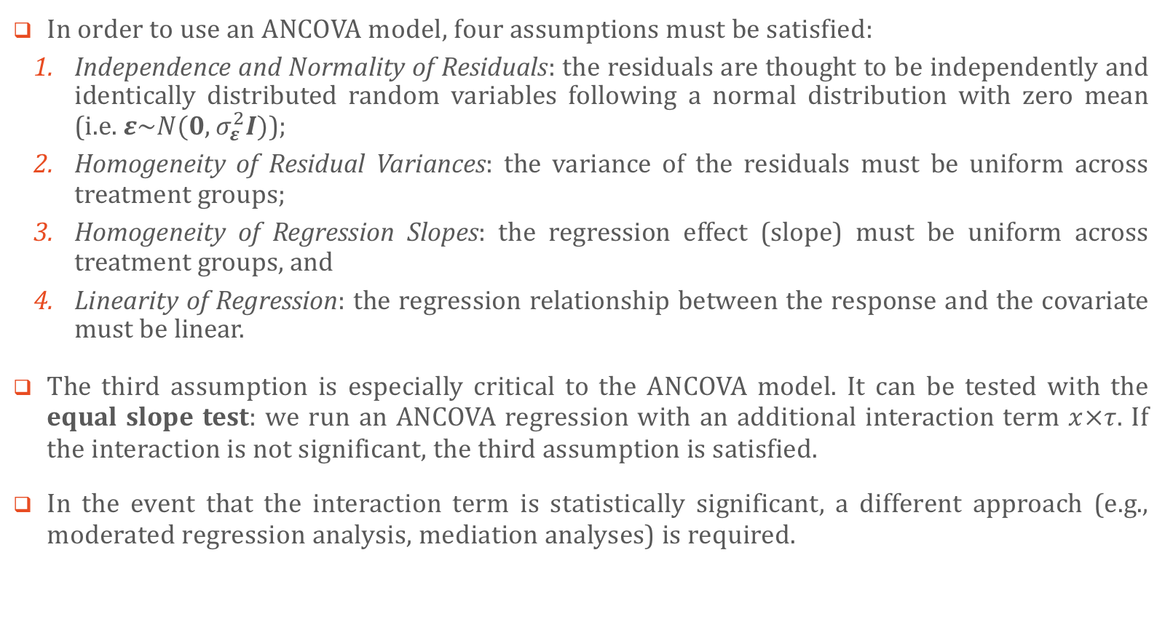
Methodology ANCOVA Models (Assumptions)
In order to use an ANCOVA model, four assumptions must be satisfied:
Independence and Normality of Residuals: the residuals are thought to be independently and identically distributed random variables following a normal distribution with zero mean (i.e. $ε\sim N(0,σ_{ε}^{2}I)$);
Homogeneity of Residual Variances: the variance of the residuals must be uniform across treatment groups;
Homogeneity of Regression Slopes: the regression effect (slope) must be uniform across treatment groups, and
Linearity of Regression: the regression relationship between the response and the covariate must be linear.
The third assumption is especially critical to the ANCOVA model. It can be tested with the equal slope test: we run an ANCOVA regression with an additional interaction term $x×τ$. If the interaction is not significant, the third assumption is satisfied.
In the event that the interaction term is statistically significant, a different approach (e.g., moderated regression analysis, mediation analyses) is required.

Slide 15
Analyses and Results

Slide 16
Analysis and Results Actual Sample Size and Effect of Imputation
A total of 129 participants were recruited for the study, ten of which dropped out after their baseline assessments. A further three drop-outs were removed, leaving a total of N = 116 participants for the IBSS analysis.
To accommodate the three imputations for missing observations, three degrees of freedom are taken from the residual source in the ANCOVA analysis.

Slide 17
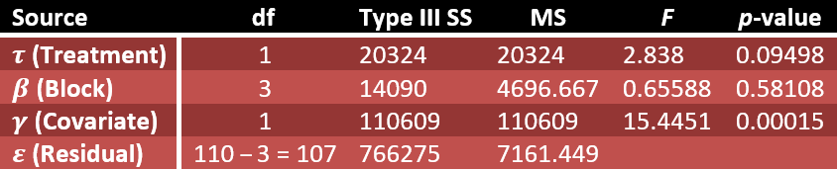
Analysis and Results ANCOVA on IBS Severity Score with Full Dataset
Using all N=116 sample, the result using IBS severity score is summarized in the following ANOVA table.
As the p-value for the treatment effect is about 0.095, we conclude that there is not enough evidence to suggest that the treatment has an effect at the 0.05 significance level (but there appears to be a significant effect of the treatment on IBSS at the 0.10 significance level)
Also, with a p-value of 0.0015 for the covariate effect, it seems reasonable to assume that the relationship between the response and the covariate is indeed linear.
ANOVA table for the Full IBSS Model with degrees of freedom modified to accommodate imputation.

Slide 18
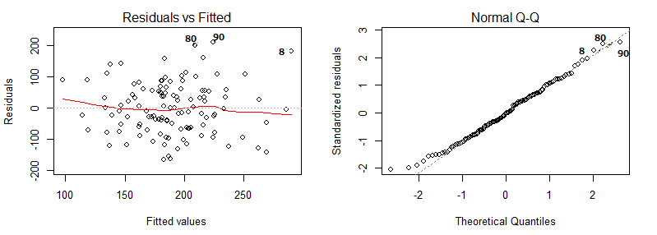

Analysis and Results ANCOVA on IBS Severity Score (Diagnostic Checks 1)
The assumption of normality and independence of residuals are satisfied based on the following plots.
The Bartlett statistic against homogeneous variances of the residuals in the treatment group vs. those in the placebo group is $X^{2}=$ 0.5437, with a corresponding p-value of 0.4450. Hence it is safe to assume that the assumption of homogeneous variances is met.
Normality and independence of the Full IBSS Model residuals.

Slide 19
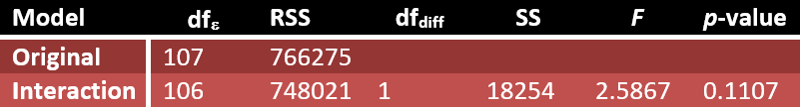
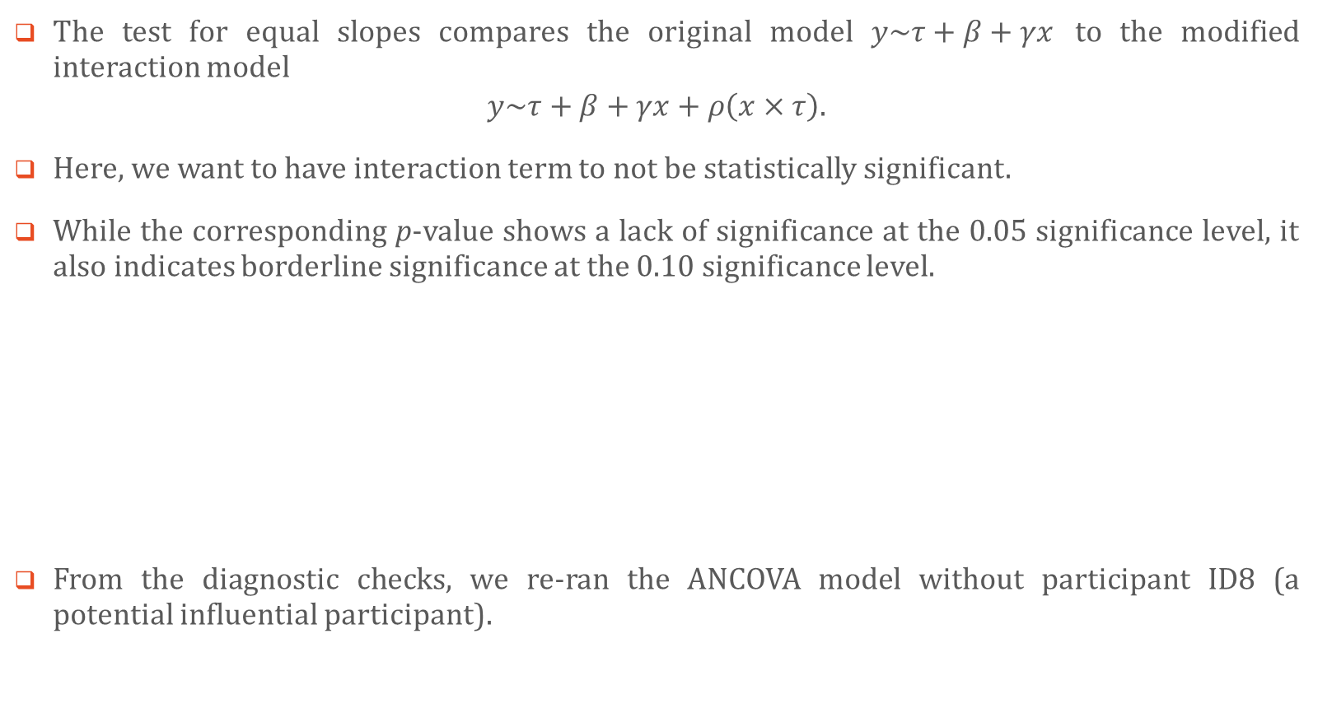
Analysis and Results ANCOVA on IBS Severity Score (Diagnostic Checks 2)
The test for equal slopes compares the original model $y\sim τ+β+γx$ to the modified interaction model
$$y\sim τ+β+γx+ρ\left(x×τ\right).$$
Here, we want to have interaction term to not be statistically significant.
While the corresponding p-value shows a lack of significance at the 0.05 significance level, it also indicates borderline significance at the 0.10 significance level.
From the diagnostic checks, we re-ran the ANCOVA model without participant ID8 (a potential influential participant).
Homogeneity of regression slopes across treatment.

Slide 20
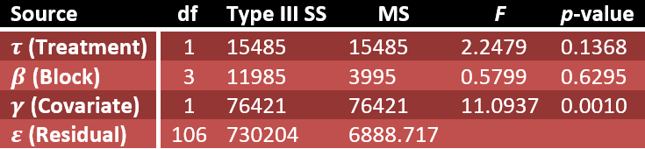
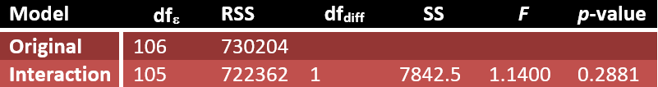
Analysis and Results ANCOVA on IBS Severity Score without ID8
The removal of ID8 has the dramatic effect of changing our conclusions to the point that there is no longer enough evidence to suggest that the treatment has an effect even at the 0.10 significance level.
The assumption of normality and independence of error terms, homogeneity of variances, and linearity of covariance effect are all met.
This concludes that participant ID 8 is indeed an influential observation, and based on IBS severity score the probiotic agent does not have statistically significant effect on IBS.
ANOVA table for the reduced model with degrees of freedom modified to accommodate imputation.
Homogeneity of regression slopes across treatment.

Slide 21
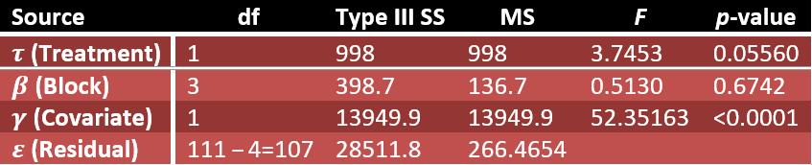
Analysis and Results ANCOVA on IBS QoL Score (Full Dataset)
As before, a total of 129 participants were recruited for the study, ten of which dropped out after the baseline assessment. This time however, only two drop-outs were removed, leaving a total of N = 117 participants for the QoL analysis. In order to accommodate the four imputations, four degrees of freedom are docked from the residual source in the ANCOVA analysis.
There is still not enough evidence to suggest that the treatment has an effect at the 0.05 significance level; however, the p-value is very close to the threshold.
ANOVA table for the Full QoL Model with degrees of freedom modified to accommodate imputation.

Slide 22
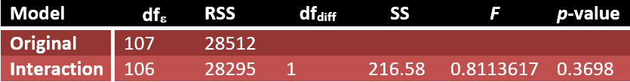
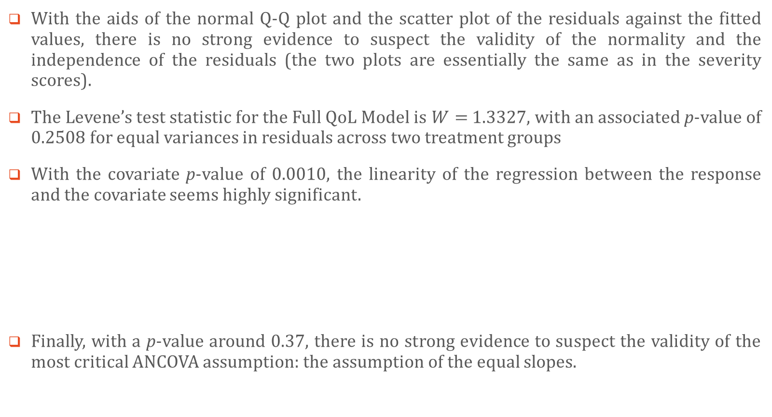
Analysis and Results ANCOVA on IBS QoL Score (Diagnostic checks)
With the aids of the normal Q-Q plot and the scatter plot of the residuals against the fitted values, there is no strong evidence to suspect the validity of the normality and the independence of the residuals (the two plots are essentially the same as in the severity scores).
The Levene’s test statistic for the Full QoL Model is $W=$ 1.3327, with an associated p-value of 0.2508 for equal variances in residuals across two treatment groups
With the covariate ­p-value of 0.0010, the linearity of the regression between the response and the covariate seems highly significant.
Finally, with a p-value around 0.37, there is no strong evidence to suspect the validity of the most critical ANCOVA assumption: the assumption of the equal slopes.
Homogeneity of regression slopes across treatment.

Slide 23

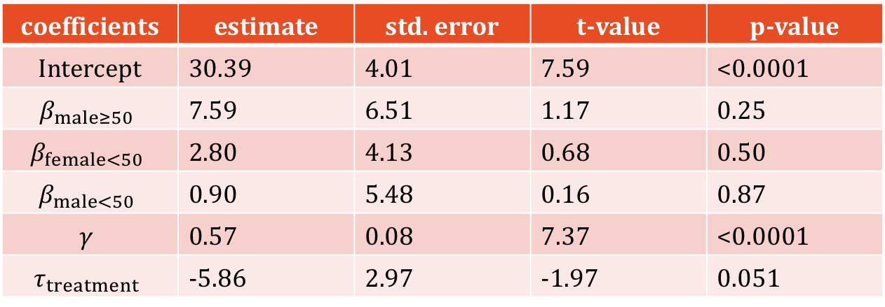
Analysis and Results Summary Table on IBS QoL Score (Full Dataset)
ANCOVA coefficients for the Full QoL Model are given below. The placebo treatment effect $τ_{1}$ and the females-over-50 block effect $β_{1}$ are both set to 0.
Intercept term(the overall mean $μ$), and the covariate effect $γ$ are thought to be significant.
Blocking does not have statistical significance.
The treatment effect $τ_{treatment}$, has a relatively small p-value; however, it is not significant at $α=0.05$.
coefficients | estimate | std. error | t-value | p-value
Intercept | 30.39 | 4.01 | 7.59 | <0.0001
$$β_{male≥50}$$ | 7.59 | 6.51 | 1.17 | 0.25
$$β_{female<50}$$ | 2.80 | 4.13 | 0.68 | 0.50
$$β_{male<50}$$ | 0.90 | 5.48 | 0.16 | 0.87
$$γ$$ | 0.57 | 0.08 | 7.37 | <0.0001
$$τ_{treatment}$$ | -5.86 | 2.97 | -1.97 | 0.051

Slide 24
Consulting Post-Mortem

Slide 25
Consulting Post-Mortem
Practical vs. Statistical significance
just because we (barely) found statistically significant result, that does not translates to practical significance (i.e., does the agent really provide more than placebo effect?)
Method of choice (ANCOVA)
ANCOVA only allow us to compare before/after treatment scores. Since we have two to three follow-ups, ANCOVA may not be the best choice to test the treatment effect over the course of three months. (We were asked to do ANCOVA analysis by our client).
Convenient recruitment process
as with most medical experiments, participants needed to come forward to participate in this study. This type of recruitment process leads to self-selection bias, and the participants may not be a representative sample of all IBS sufferers.
Effect of blocking
From statistical perspective, blocking should only be used if there are compelling reasons to suspect that treatment effects are different for at least one subgroup as blocking results in a fewer degrees of freedom.
Never stop digging until we find something
After the above results were shown, the client kept asking us to provide further analyses (e.g., considering only severe IBS suffers). Running enough tests, we may find something; however, this does not really mean anything (other than misleading conclusion!)
Privacy concerns
The files we received contained participants’ full names.

